Slide 1
Project Lung
Xin Ma, Yuyang Zhang

Slide 2
Pipeline of lung’s H&E and CODEX

Slide 3
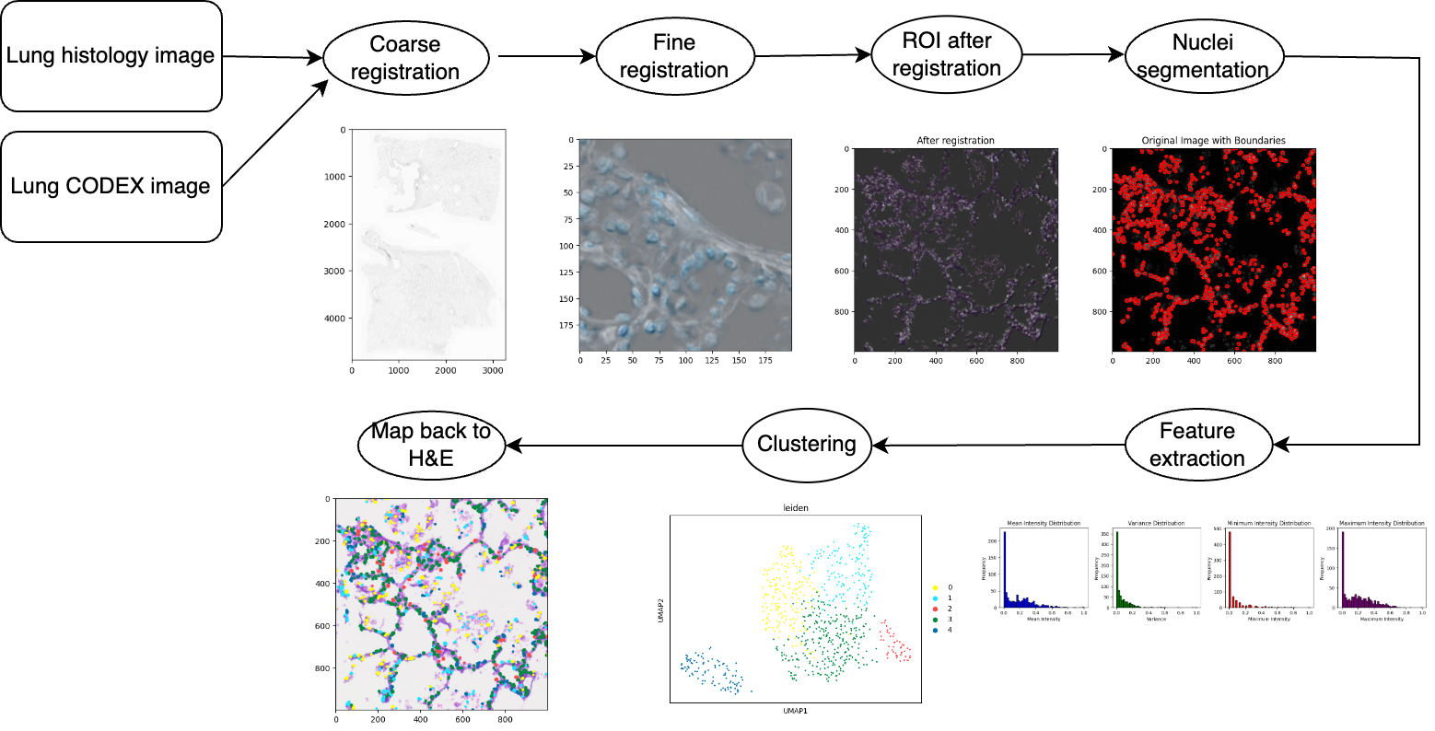

Slide 4
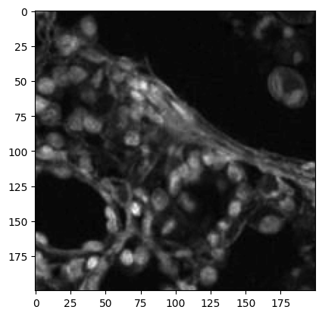
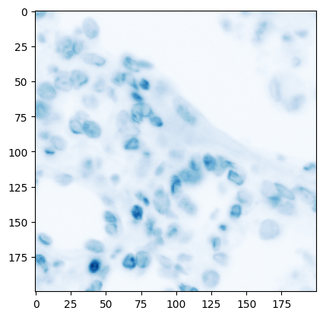
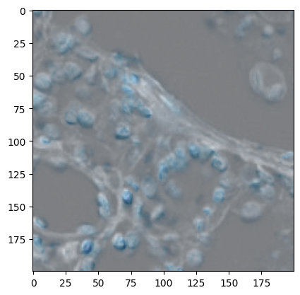
Pipeline of lung’s H&E and CODEX (Image registration)
H&E
DAPI
Result

Slide 5
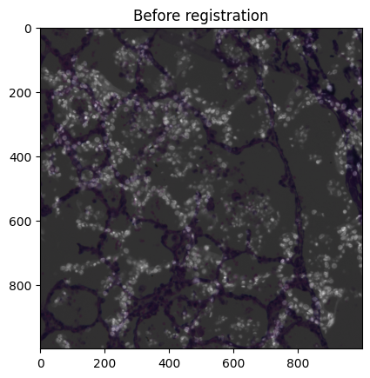
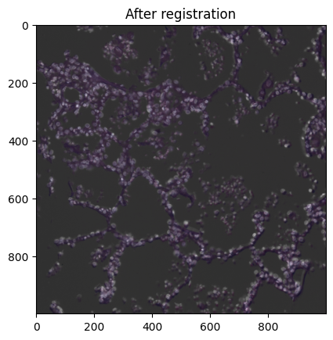
Pipeline of lung’s H&E and CODEX (Image registration)

Slide 6
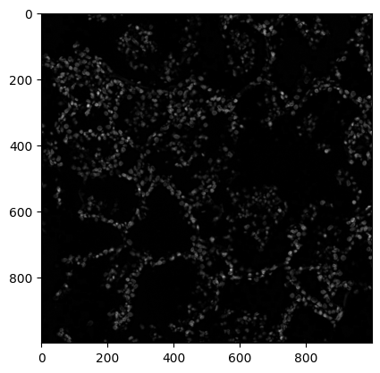
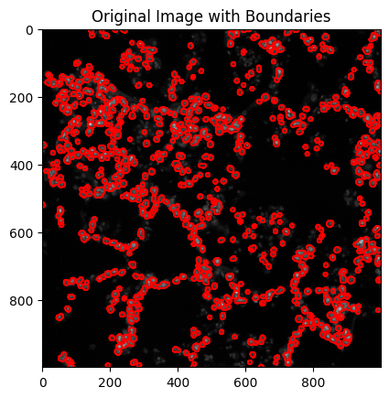
Pipeline of lung’s H&E and CODEX (Nuclei segmentation)
Notes:
Add dilation

Slide 7
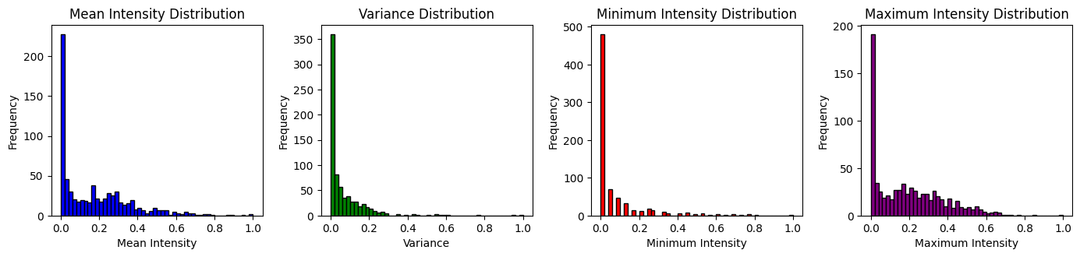
Pipeline of lung’s H&E and CODEX (Feature extraction)
The feature matrix size is (736, 140)

Slide 8
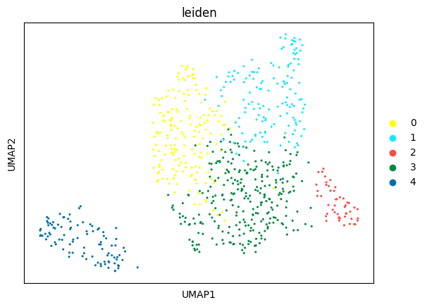
Pipeline of lung’s H&E and CODEX (Leiden cluster)

Slide 9
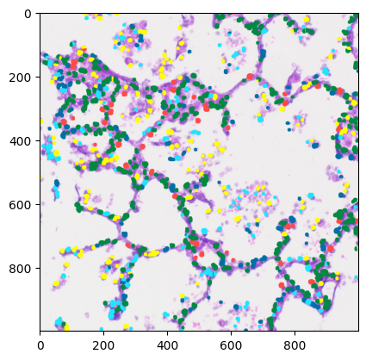
Pipeline of lung’s H&E and CODEX (Map back to H&E)

Slide 10
Observation of lung’s H&E and CODEX pipeline result
The nuclei that have high intensity (green) are distributed in the main tissue of lung cells.
The secondary tissue of lung cells is mostly composed of nuclei that have low intensity(yellow and light blue)

Slide 11
Pipeline of kidney with glom

Slide 12
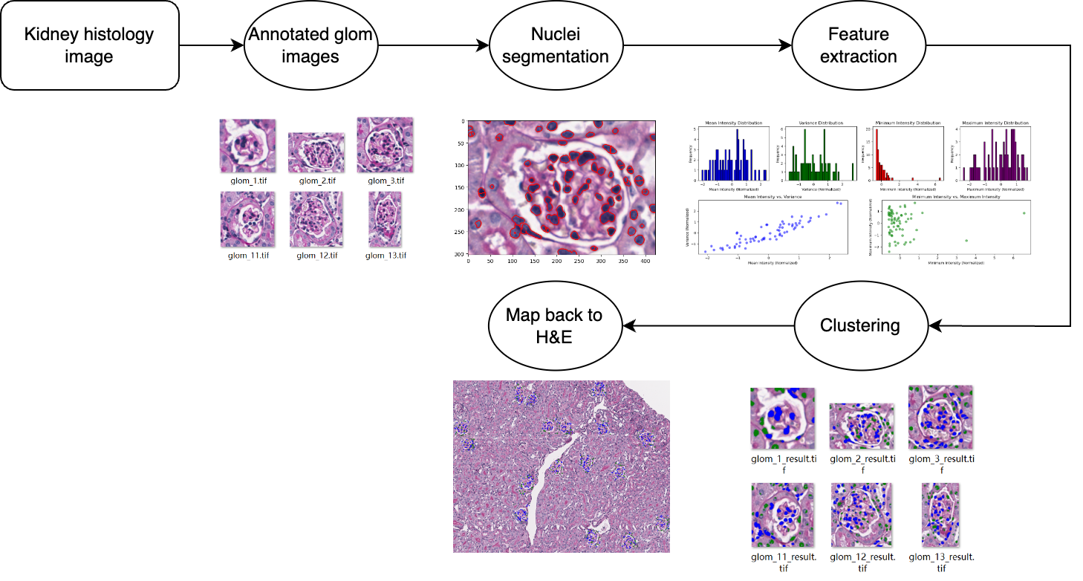

Slide 13
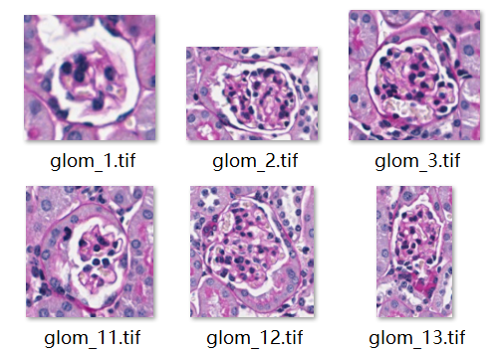
Pipeline of kidney with glom (Annotated glom images)

Slide 14
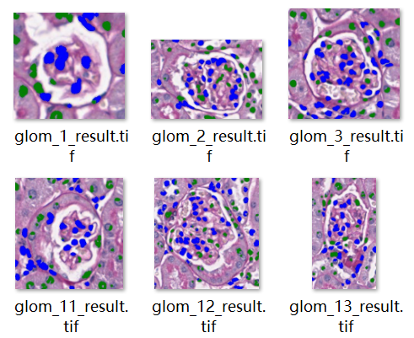
Pipeline of kidney with glom
Nuclei segmentation
Feature extraction
Kmean cluster

Slide 15
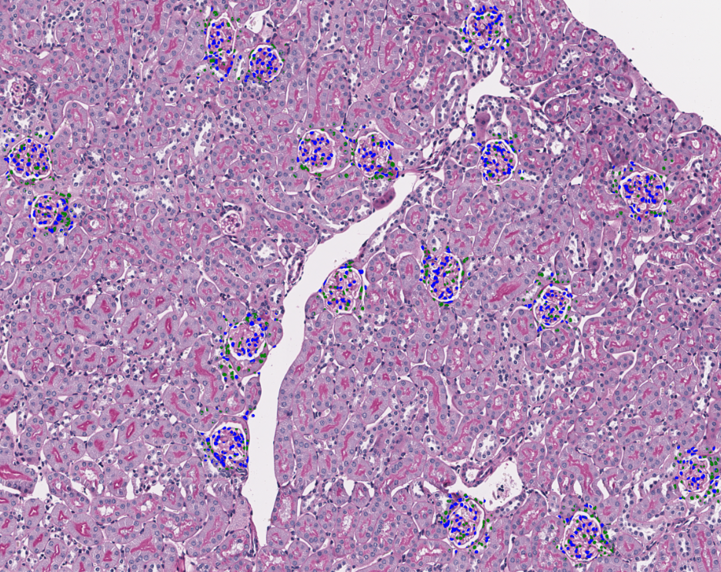
Pipeline of kidney with glom (Map back to H&E image)

Slide 16
Observation of kidney with glom pipeline result
Middle part of most glomeruli is composed of most high-intensity nuclei (blue), while most of the nuclei in the edge part are low-intensity (green)
No glomerulus whose center is mostly composed of low-intensity nuclei (green)
The middle part of few glomerulus is composed of mixed high-intensity and low-intensity nuclei

Slide 17
Result/Discussion
We speculate that when a cell is more metabolically active, its nuclei appear more intense when viewed under a microscope, and vice versa. So we conclude that:
Cells with higher intensity nuclei are more active and responsible for specific biological functions
Cells with lower intensity nuclei play a role in structural support and maintenance of the surrounding environment.

Slide 18
Thank you!

